Slide 1
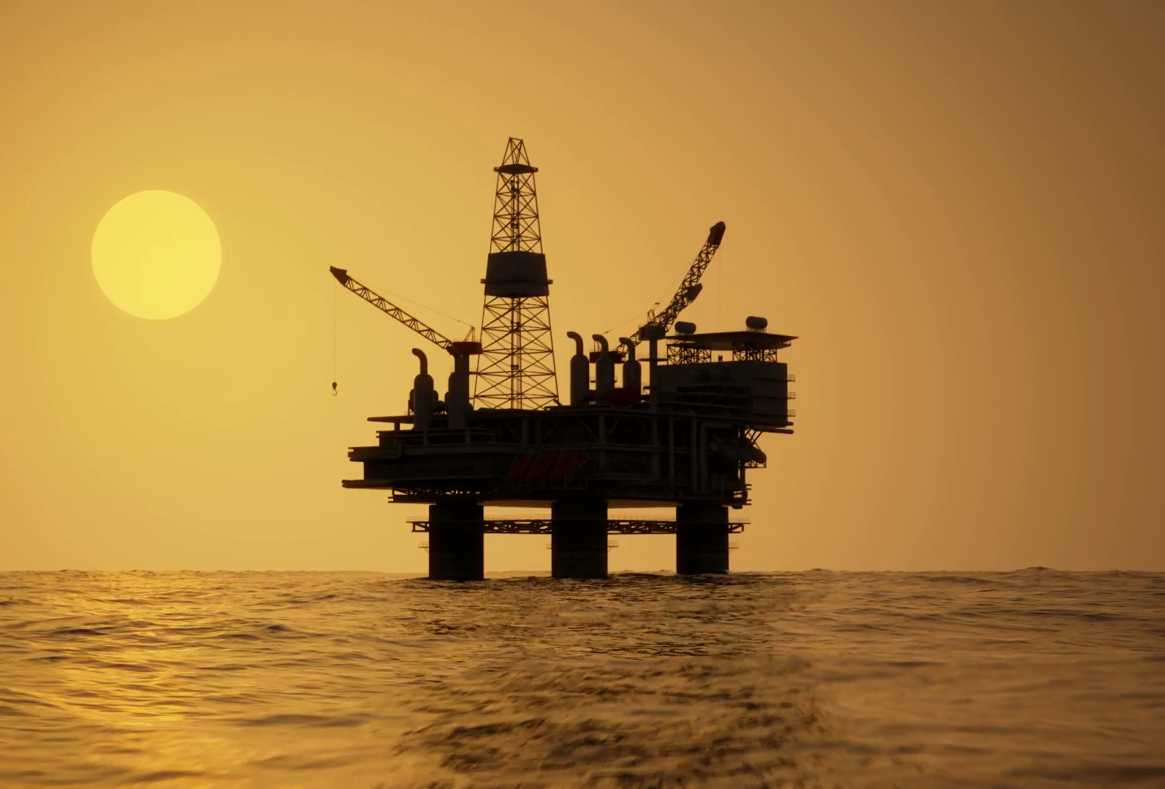
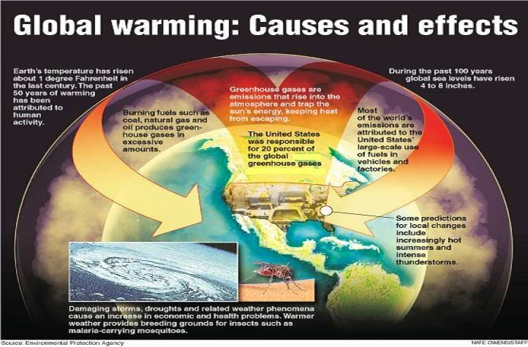
Create a Brochure
May 8 th 2025 / 2 A/ 2 B
Esta foto de Autor desconocido está bajo licencia CC BY-NC
Esta foto de Autor desconocido está bajo licencia CC BY

Slide 2
What do you have to include?
Include what is global warming ?
Include what is climate change?
Include what are de factors that influenced the global warming ?
Include what are the consequences of the global warming? For people and nature
Include what are footprints and how affect out planet?
Include ideas to help and care our planet at least 3 activities

Slide 3
Important notes
Your brochure must be attractive, in terms of colour, words and images.
Also you have to write in clear way so that everybody can understand.

